Slide 1
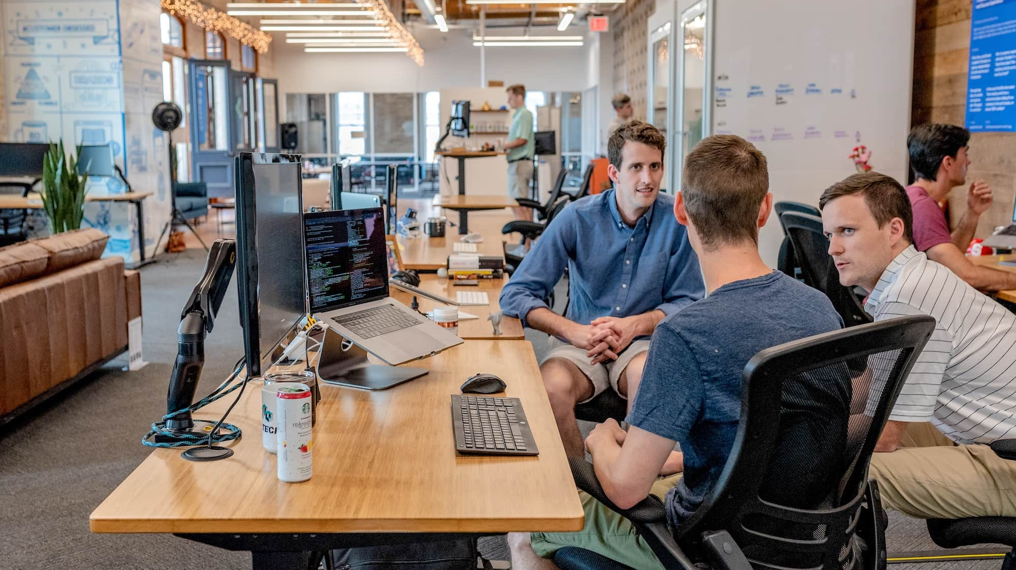
MERCH STORY
28 Corporate Gifting Ideas
for Gen-Z Employees
in the Age of AI
Less waste. More output. Better adoption.
Bulk
Branding
Pan-India Delivery
February 2025

Slide 2
EXECUTIVE SUMMARY
Why Gifting Matters Now
Retention Crisis
Hybrid Work Demands
AI-Driven Recognition
74% of Gen-Z would leave for better pay. Recognition gaps accelerate exits. Strategic gifting is a measurable retention tool.
71% prefer hybrid work. Physical touchpoints matter more when face-time is limited. Gifts bridge the distance.
Automated triggers for milestones need physical fulfillment. AI handles timing; gifts deliver the human touch.
Three Outcomes HR/CEOs Want
Measurable Usage
Brand Consistency
Cultural Alignment
Gifts that get used weekly, not stored in drawers
Unified experience across distributed teams
Values-driven gifting that resonates with Gen-Z ethics
28 curated ideas across 6 categories
Complete procurement playbook
Supplier vetting checklist
Merch Story end-to-end execution

Slide 3
THE TRUTH SLIDE
What Gen-Z Actually Uses
Practical > Decorative
Hybrid Work Productivity
Items that solve daily problems win. Desk ornaments and trophy-style gifts are ignored. Functionality is the first filter.
Gifts must work in both home and office environments. Single-location items limit usage. Portability and flexibility are essential.
Identity + Values Alignment
Unboxing + Personalization
44% would reject employers not matching their ethics. Eco-consciousness is non-negotiable. Plastic-heavy gifts signal misalignment.
The experience matters—but plastic-heavy packaging is a negative signal. Sustainable unboxing enhances perceived value.
The 7-Day Rule
If it doesn't get used within 7 days, the gift has failed.
Source: Gen-Z Workplace Study 2024

Slide 4
AI ERA TRANSFORMATION
What Changed
AI Makes Work Faster
Digital Triggers
Measurable Adoption
Humans now value recognition and wellbeing more, not less. As AI handles routine tasks, the human elements of work gain importance.
Milestone-based gifting at scale. Work anniversaries, project completions, performance thresholds can auto-trigger gift fulfillment.
Track which gifts get used (weekly active usage), which get shared on social, and which drive retention signals.
Recognition demand ↑ 40%
Platforms: HiFives, Leena AI
Data-driven gifting decisions
The New Mandate
85%
52%
12-15%
Gifts must justify their existence through usage data, not just sentiment. HR leaders need measurable signals of gift effectiveness.
Remember gifts
Higher retention
Satisfaction boost

Slide 5
STRATEGIC FRAMEWORK
The 3-Pillar Framework
Less Waste → More Output → More Brand Recall
Less Waste
More Output
More Brand Recall
×
×
Reusable items
Productivity enhancers
Subtle branding
Recyclable materials
Comfort items
Premium finishing
Plantable products
Daily-use essentials
Long-life items
Minimal packaging
Hybrid-work compatible
QR codes to culture
Certified sustainable
Long battery/durability
Visible daily use
Effective Corporate Gifting Happens Here
Intersection of all three pillars

Slide 6
DECISION TOOL
How to Choose the Right Gift: 5-Minute Decision Matrix
The Matrix Dimensions
Scoring Guide
1
Utility
Score 20+
Will it be used weekly?
Automatic winner
2
Sustainability
Score 15-19
Eco-credentials visible?
Viable with trade-offs
3
Brandability
Score <15
Can it carry subtle logo?
Eliminate
4
Budget
Fits tier (<₹800 / ₹800-2,500 / ₹2,500-7,500)?
Sample Scores
5
Shipping Ease
Bamboo bottle
23/25
Can it reach remote employees?
Plastic trophy
8/25
Wireless charger
21/25
Shortlist in 10 minutes, not 10 hours. This matrix enables rapid decision-making for busy HR teams.

Slide 7
NAVIGATION
Table of Contents
A
Productivity & AI-Ready Desk
E
Creator + Learning Kits
6 ideas for the modern workspace
4 skill-building gifts Gen-Z loves
B
Eco-Friendly Daily Essentials
F
Experience + Digital Gifting
6 sustainable everyday items
2 non-physical options
C
Hybrid Work Travel + Commute
G
Procurement Playbook
5 mobility-focused gifts
7-step process, supplier checklist, negotiation
D
Wellness & Recovery
H
Why Merch Story + CTA
5 health and balance items
Our execution model and next steps
Click any section to navigate • All product links included

Slide 8
CATEGORY A
6 IDEAS • PRODUCTIVITY FOCUS
Productivity & AI-Ready Desk
1
Ergonomic Laptop Stand
2
Mechanical Keyboard
3
Mouse + Desk Mat Combo
Wood/aluminium. Improves posture, reduces neck strain.
Tactile feedback boosts typing speed. Budget + premium options.
Recycled or vegan leather options. Daily desk essential.
₹800-2,500
₹2,500-7,500
₹800-2,500
Laser engraving
Custom keycaps
Embossing/UV
MOQ: 50 | 10-12 days
MOQ: 25 | 14-18 days
MOQ: 50 | 7-10 days
Amazon
Amazon
Amazon
4
USB-C Hub / Multiport
5
Wireless Charger
6
Noise-Cancelling Headset
Essential for modern laptops. Expands connectivity.
Qi-certified. 3-in-1 docks for phone/watch/earbuds.
Entry + mid-tier options. Essential for focus work.
₹800-2,500
₹800-2,500
₹2,500-7,500
Laser on metal
UV print
Laser on earcups
MOQ: 50 | 10-12 days
MOQ: 50 | 7-10 days
MOQ: 20 | 14-20 days
Amazon
Amazon
Amazon
Merch Story can supply + brand + deliver pan-India with GST invoicing
themerchstory.com →

Slide 9
CATEGORY B
6 IDEAS • SUSTAINABILITY FOCUS
Eco-Friendly Daily Essentials
7
Bamboo/Steel Bottle
8
Borosilicate Cup + Bamboo Lid
9
Plantable Stationery Kit
Double-wall insulation. Keeps drinks hot/cold 12+ hours.
Plastic-free daily use. Reusable mug for coffee/tea.
Seed paper notebook + pen/pencil that grows into plants.
₹800-2,500
<₹800
₹800-2,500
Laser engraving
Laser/screen
Seed paper custom
MOQ: 50-100 | 10-12 days
MOQ: 100 | 7-10 days
MOQ: 50 | 12-15 days
Amazon
Amazon
Amazon
Seedballs
10
Cork Notebook + Cardholder
11
rPET Backpack/Laptop Sleeve
12
Desktop Plant/Oxygen Kit
Low-waste feel, biodegradable. Natural texture premium.
Made from 12-15 recycled bottles. Visible sustainability.
Minimal packaging. Improves air quality, reduces stress.
₹800-2,500
₹800-2,500
<₹800
Debossing
Embroidery/screen
Pot engraving
MOQ: 50 | 10-12 days
MOQ: 50 | 12-15 days
MOQ: 50 | 7-10 days
Amazon
Amazon
Amazon
80% of procurement heads prefer eco-friendly gifts. Source: ChocoCraft Report 2024
Sustainable Guide →

Slide 10
CATEGORY C
5 IDEAS • MOBILITY FOCUS
Hybrid Work Travel + Commute
13
Premium Laptop Backpack
14
Tech Organiser Pouch
15
Compact Umbrella
Durable, water-resistant. Padded compartments for devices.
Cables, chargers, adapters in one place. Travel essential.
Windproof design. Essential for Indian monsoons.
₹2,500-7,500
<₹800
<₹800
Embroidery/metal badge
Debossing/screen
Screen on sleeve
MOQ: 25 | 14-18 days
MOQ: 100 | 7-10 days
MOQ: 100 | 7-10 days
Amazon
Amazon
Amazon
16
Travel Tumbler + Cutlery Set
17
RFID Wallet/Card Holder
Zero waste on-the-go. Stainless steel, bamboo options.
Vegan leather or cork options. Protects against digital theft.
₹800-2,500
<₹800
Laser on tumbler
Debossing
MOQ: 50 | 10-12 days
MOQ: 100 | 7-10 days
Amazon
Amazon
71% of Gen-Z prefer hybrid work. Mobility-focused gifts match their lifestyle.
Gen-Z Ideas →

Slide 11
CATEGORY D
5 IDEAS • WELLNESS FOCUS
Wellness & Recovery
18
Blue-Light Glasses
19
Mini Massage Gun
20
Aroma Diffuser + Oils
Quality frames reduce eye strain. Screen-time essential.
Compact, portable recovery. Post-workout or desk relief.
Stress relief. Essential oil set for home/office.
₹800-2,500
₹2,500-7,500
₹800-2,500
Laser on temple
Screen on case
Laser on base
MOQ: 50 | 10-12 days
MOQ: 20 | 14-18 days
MOQ: 50 | 10-12 days
Amazon
Amazon
Amazon
21
Fitness Band/Posture Corrector
22
Hydration + Snack Box
Track activity or improve posture. Health-conscious choice.
Eco packaging, local sourcing. Healthy workplace fuel.
₹800-2,500
<₹800
Screen on band
Box sleeve
MOQ: 50 | 10-14 days
MOQ: 100 | 7-10 days
Amazon
Amazon
92% of Gen-Z graduates want to discuss mental health at work. Wellness gifts show you care.
Gen-Z Ideas →

Slide 12
CATEGORY E
4 IDEAS • SKILL-BUILDING FOCUS
Creator + Learning Kits
Gifts Gen-Z actually wants to receive
23
Creator Kit
24
Digital Note Tablet
Tripod + clip mic + ring light for remote content creation. Side-hustle essential.
E-ink writing pad for digital note-taking. Paperless productivity.
₹2,500-7,500
Laser on tripod
₹2,500-7,500
Screen on bezel
MOQ: 20
14-18 days
MOQ: 20
14-18 days
Amazon: Creator Kits
Amazon: E-ink Tablets
25
Online Course Voucher
26
"Build Your AI Workflow" Kit
Learning wallet for Coursera, Udemy, LinkedIn Learning. Flexible skill development.
Prompt cards + notebook + quick guide. Highly brandable, timely topic.
₹2,500-7,500
Custom voucher
₹800-2,500
Full customization
MOQ: 25
Instant
MOQ: 50
10-12 days
Coursera
Udemy
Amazon: AI Productivity
70% of Gen-Z expect promotion within 18 months. Learning gifts support their growth mindset.
AI Era Guide →

Slide 13
CATEGORY F
2 IDEAS • ZERO WASTE
Experiences + Digital Gifting
Non-physical options with maximum flexibility
27
Digital Gift Card Ecosystem
28
Paid Day Off + Experience Voucher
Multi-brand choice: Amazon, Flipkart, food delivery, wellness apps
Time + experience combo: PTO with curated activity
Recipient chooses what they actually want
Experience options: Dining, adventure, wellness, staycations
Zero waste — no packaging, no shipping
Higher perceived value than physical gifts
Instant delivery — perfect for last-minute
Memories over things — aligns with Gen-Z values
₹500-5,000+
Custom email/card
₹2,500-7,500
Branded voucher
MOQ: 25
Instant
MOQ: 25
7-10 days setup
Amazon Gift Cards →
Flipkart →
Xoxoday →
Woohoo →
Both options eliminate physical waste while delivering high perceived value
Zero shipping • Zero packaging
Perfect for eco-conscious companies and distributed teams
Maximum flexibility

Slide 14
PROCUREMENT PLAYBOOK
How to Procure in 7 Steps (Zero Chaos)
1
Define Objective
5
QC Checklist + Stress Tests
Onboarding / milestone / performance / festival. Set measurable goals (usage rate, satisfaction score).
Durability, branding adhesion, packaging integrity. Document standards.
6
Confirm Branding + Packaging
2
Choose Budget & Persona
Method (laser/emboss/UV/DTF/screen), placement, colors. Approve mockups.
Select tier (<₹800, ₹800-2,500, ₹2,500-7,500) and persona (Gen-Z, remote, sales, tech).
7
Bulk Production + Fulfillment
3
Shortlist 8-12 Items
Production tracking, QC checkpoints, delivery plan with SLA. Multi-city coordination.
Use the decision matrix. Mix categories for variety. Consider regional preferences.
Timeline Estimates
4
Request Samples
100 units
10 days
With branding proof. Test quality, finish, packaging. Get stakeholder feedback.
500+ units
14-18 days
1,000+ units
18-25 days
Pro tip: Start 3-4 weeks before your event. Festive seasons (Diwali, New Year) add 5-7 days.

Slide 15
SUPPLIER EVALUATION
Supplier Vetting Checklist
Spot the right supplier fast — eliminate 80% in 15 minutes
In-House Branding vs Outsourcing
Packaging Standards
In-house = faster turnaround, better QC control
Less plastic, recyclable materials. Eco-alignment check.
MOQ & Scalability
References + Corporate Clients
Can they handle 50 to 5,000 units? Growth-ready?
Ask for case studies. Talk to past clients.
Lead Time with Buffers
GST + Compliance Readiness
Standard timeline + contingency planning for delays
Proper documentation, tax invoices, legal compliance
Material Certificates
SLA for Delivery
rPET, bamboo, FSC where applicable. Verify claims.
Multi-city, tracking, proof of delivery. Penalties for delays?
Defect Replacement Policy
Sample-to-Bulk Consistency
Clear rework/replacement terms. Who pays for defects?
Ensure what you see is what you get. No bait-and-switch.
Use this checklist to eliminate 80% of unqualified vendors in 15 minutes. Focus remaining time on viable partners.

Slide 16
NEGOTIATION STRATEGY
Bulk Negotiation Framework
Win-win terms that save 15-25% on total program cost
Tiered Pricing by Quantity
Free Spares
Ask for 50/100/250/500/1,000+ unit brackets. Higher volume = lower per-unit cost.
Negotiate 1-2% extra units for defects at no cost. Buffer for quality issues.
Batch QC + Pre-Dispatch Approval
Total Landed Cost
Photo/video verification before shipping. No surprises on delivery.
Negotiate product + branding + packaging + shipping. Not just unit price.
Clear Rework Clause
Lock Rates with Forecast
Define timelines and responsibilities for defects. Who pays? How fast?
Agree on annual volume for price protection. Quarterly reviews.
Typical Savings
Payment Terms
Tiered pricing
8-12%
Partial advance + milestone-based (sample approval, production start, pre-dispatch).
Total landed cost
5-8%
Annual lock
3-5%
Total potential
15-25%
Build supplier relationships, not just transactions. Long-term partners deliver better quality and priority service.

Slide 17
BRANDING EXCELLENCE
How Branding Should Work
So it looks premium, not promotional
Branding Options by Item Type
Placement Rules
Laser Engraving
Subtle beats loud. Bottom of bottle, inside notebook cover, back of device
Metal, wood, premium feel. Permanent, elegant.
Natural touchpoints. Where hands naturally rest
Embossing/Debossing
Avoid dead-center logos that scream "promotional"
Leather, cork. Subtle luxury. Tactile impression.
UV Printing
Color Rules
Plastic, multi-color. Vibrant, durable.
One color for minimal waste and elegance
DTF/Screen Printing
Match brand guidelines exactly (Pantone/spec)
Fabric, bags, apparel. Bold colors.
Tone-on-tone for premium feel (subtle contrast)
Embroidery
Textiles, premium finish. Long-lasting.
Packaging Inserts
Extends brand experience
Welcome note + QR code linking to company culture/values page + care instructions
Tracks engagement

Slide 18
SUSTAINABLE PACKAGING
Less Waste Packaging That Still Feels Premium
Recyclable Kraft Boxes
Avoid Plastic Window Boxes
Rigid construction, minimal lamination. Natural texture signals eco-consciousness. Custom printing with soy-based inks.
Unless absolutely required for product visibility. Use die-cut cardboard windows instead.
Reusable Pouches
Protective Packaging
Cotton, jute, or recycled PET bags. Serves a second purpose — storage, shopping, travel. Extends brand visibility.
Molded pulp instead of foam. Corrugated inserts instead of bubble wrap. Paper-based tape instead of plastic.
Plantable Paper Inserts
Unboxing Experience
Seed paper cards that grow into plants. 100% recycled paper with visible fibers. Message + sustainability combined.
Layered reveal, tissue paper with brand stamp, handwritten-style note. Sustainability + delight.
The Goal
Perceived value ↑
Recipient should feel the sustainability intention without feeling the packaging is "cheap."
Environmental impact ↓

Slide 19
WHY MERCH STORY
End-to-End Execution Partner
End-to-End Service
Eco-Friendly Catalog
High-Quality Branding
Sourcing + sampling + branding + fulfillment from a single partner. No coordination headaches. One point of contact.
Curated selection of cork, bamboo, plantable, rPET, FSC-certified options. Sustainability without compromise.
Embossing, embroidery, UV printing, laser engraving with premium finishing. Subtle, not loud.
Bulk Pricing
Pan-India Delivery
Corporate Workflow
Competitive rates with transparent pricing. Tiered discounts for volume. No hidden costs.
Single-point logistics management. Multi-city coordination. Tracking and proof of delivery.
Formal quotes, sample approvals, production tracking, GST invoicing. Enterprise-ready processes.
Merch Story Resources
Gen-Z Ideas →
Sustainable →
AI Era →
Deep dives into Gen-Z gifting, sustainability, and AI-era procurement

Slide 20
EXECUTION TIMELINE
Merch Story Process
From brief to delivery — clear milestones, no surprises
Day 0-2
Day 3-5
Day 6-10
Day 11+
Shortlist + Quote
Samples + Branding
Production
Fulfillment + Delivery
Share requirements: quantity, budget, logo, delivery date. Receive curated recommendations and pricing.
Physical samples shipped for evaluation. Digital mockups for branding approval. Iterate if needed.
Bulk manufacturing with QC checkpoints. Mid-production photos available. Branding application.
Packaging, final QC, pan-India dispatch with tracking. Proof of delivery for all locations.
100 units
500+ units
1,000+ units
10 days
14-18 days
18-25 days
Rush options available for urgent requirements with 20% premium. Festive seasons add 5-7 days.

Slide 21
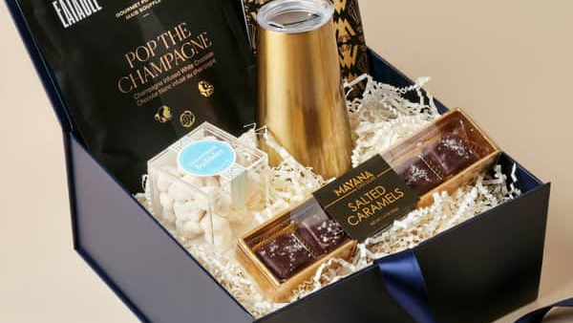
GET STARTED
Request Bulk Quote + Free Sampling
Three simple steps to get started
1
2
3
Share Your Requirements
Receive Recommendations
Get Free Samples
City, quantity, budget per employee, logo file, delivery date
Curated options within 24 hours with pricing and timelines
Physical samples with branding proof for qualified orders (50+ units)
Contact Us
Visit Website →
Visit www.themerchstory.com for full catalog
Bulk enquiry via contact form
Free sampling for 50+ units
24-hour response time

Slide 22
APPENDIX
Quick SKU Shortlist Templates
Ready-to-use combinations by budget and use case
BUDGET
<₹800 per employee
BUDGET
₹800-2,500 per employee
BUDGET
₹2,500-7,500 per employee
Tech organiser pouch
Bamboo bottle
Mechanical keyboard
Reusable mug/cup
Laptop stand (wood)
Premium backpack
Plantable pencils (set)
Wireless charger
Noise-cancelling headset
RFID wallet
Cork notebook
Creator kit
Compact umbrella
Blue-light glasses
Digital note tablet
Desktop plant
Travel tumbler + cutlery
Course voucher
Best for: Large teams, high-frequency gifting
Best for: Standard employee gifting, onboarding
Best for: Leadership, milestones, high-performers
Use Case Templates
New Joinee
Milestone
Performance
Festival
Remote Work
5-7 items
3-5 items
2-3 premium
Curated hamper
Productivity kit

